Slide 1
TRAITS AND REFLECTION IN PHP

Slide 2
Learning Objectives
Understand the concept and use of traits in PHP.
Learn how to combine multiple traits in one class.
Explore PHP Reflection and how it helps inspect classes, methods, and properties at runtime.
Apply traits and reflection in practical OOP scenarios.

Slide 3
What are Traits?
A trait is a mechanism for code reuse in PHP.
Traits help avoid duplication when multiple classes need the same method.
Defined using the trait keyword.
Cannot be instantiated directly.

Slide 4
What are Traits?
A trait is a mechanism for code reuse in PHP.
Traits help avoid duplication when multiple classes need the same method.
Defined using the trait keyword.
Cannot be instantiated directly.

Slide 5
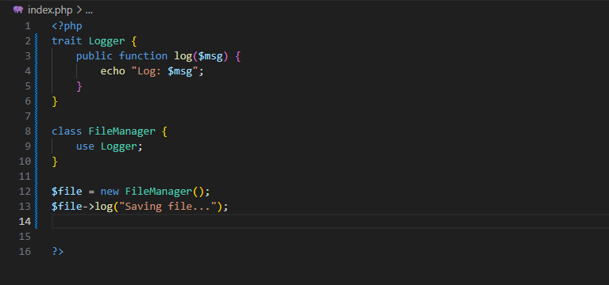
Sample Syntax
Notes:
Create a trait named Greeter with method greet($name) that echoes “Hi, $name!”

Slide 6
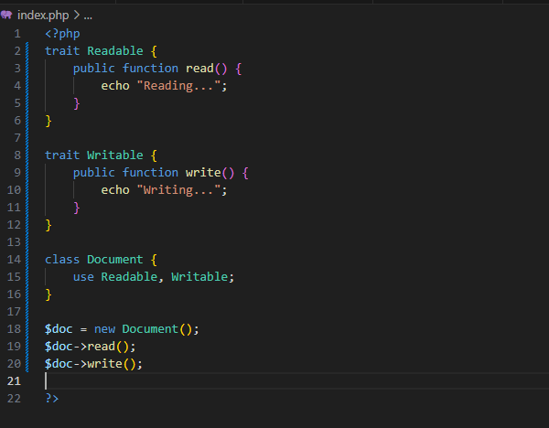
Using Multiple Traits
Notes:
Make a class Editor that uses traits Cut and Paste.

Slide 7
What is Reflection in PHP?
Reflection lets you inspect and interact with code at runtime.
You can get class properties, methods, parameters, etc.
Useful for debugging, testing, or building dynamic applications.
Notes:
Create a class Toolbox with 3 methods. Use reflection to print all method names.

Slide 8
Reflection – Get Properties and Methods
getMethods() – Returns all class methods.
getProperties() – Returns all class properties.
hasMethod("name") – Checks if method exists.
Notes:
Create a class Toolbox with 3 methods. Use reflection to print all method names.
<?php
class Car {
public string $brand;
private int $year;
protected string $engine;
public function drive() {
echo "Driving...\n";
}
private function startEngine() {
echo "Starting engine...\n";
}
protected function stopEngine() {
echo "Stopping engine...\n";
}
}
$ref = new ReflectionClass('Car');
$properties = $ref->getProperties();
echo "Properties of class Car:\n";
foreach ($properties as $prop) {
$visibility = implode(' ', Reflection::getModifierNames($prop->getModifiers()));
echo "- " . $prop->getName() . " ($visibility)\n";
}
$methods = $ref->getMethods();
echo "\nMethods of class Car:\n";
foreach ($methods as $method) {
$visibility = implode(' ', Reflection::getModifierNames($method->getModifiers()));
echo "- " . $method->getName() . " ($visibility)\n";
}

Slide 9
Common Reflection Classes
ReflectionClass – for inspecting a class
ReflectionMethod – for class methods
ReflectionProperty – for properties
ReflectionFunction – for functions

Slide 10
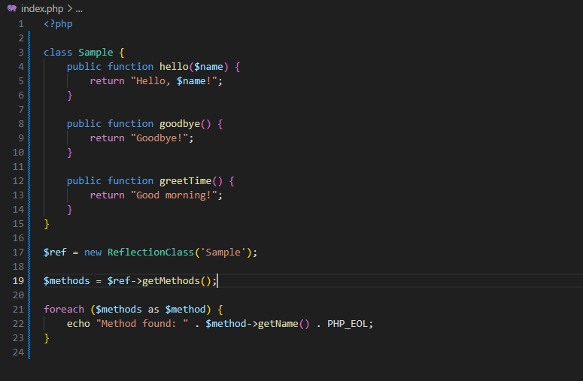
Sample Syntax

Slide 11
Summary
✅ Traits = reusable code blocks across classes.
✅ You can combine and resolve conflicts using insteadof, as.
✅ Reflection = examining PHP classes at runtime.
✅ Used in debugging, testing, and frameworks

Slide 12
Thank You

